Slide 1
Trends in Online Entertainment during the Pandemic
Team AJA

Slide 2
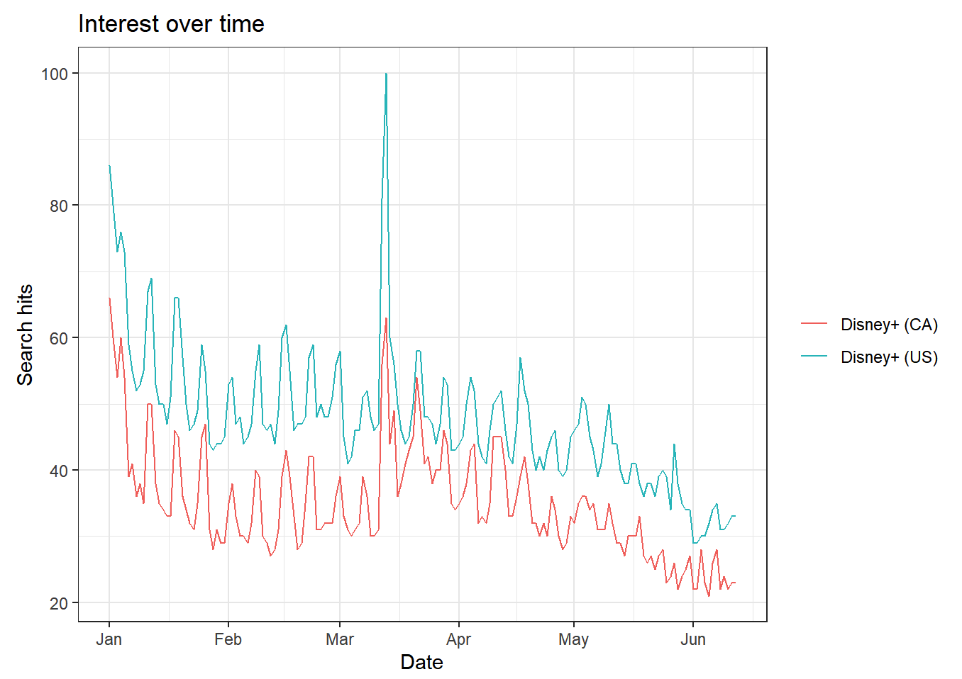
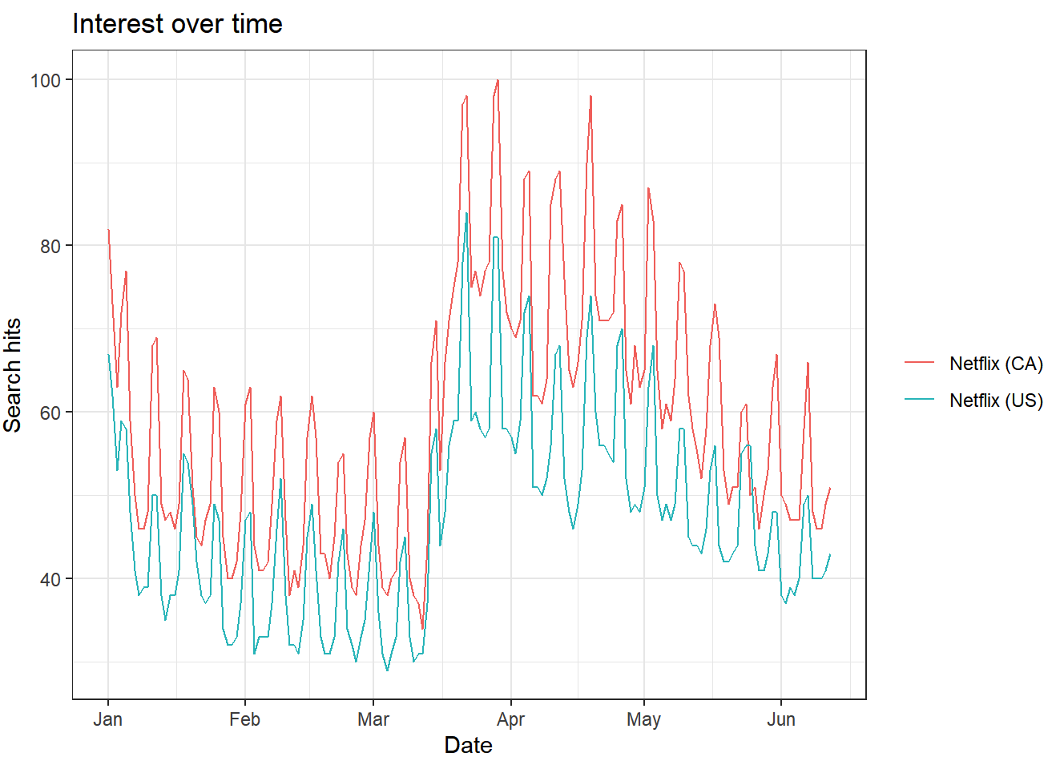
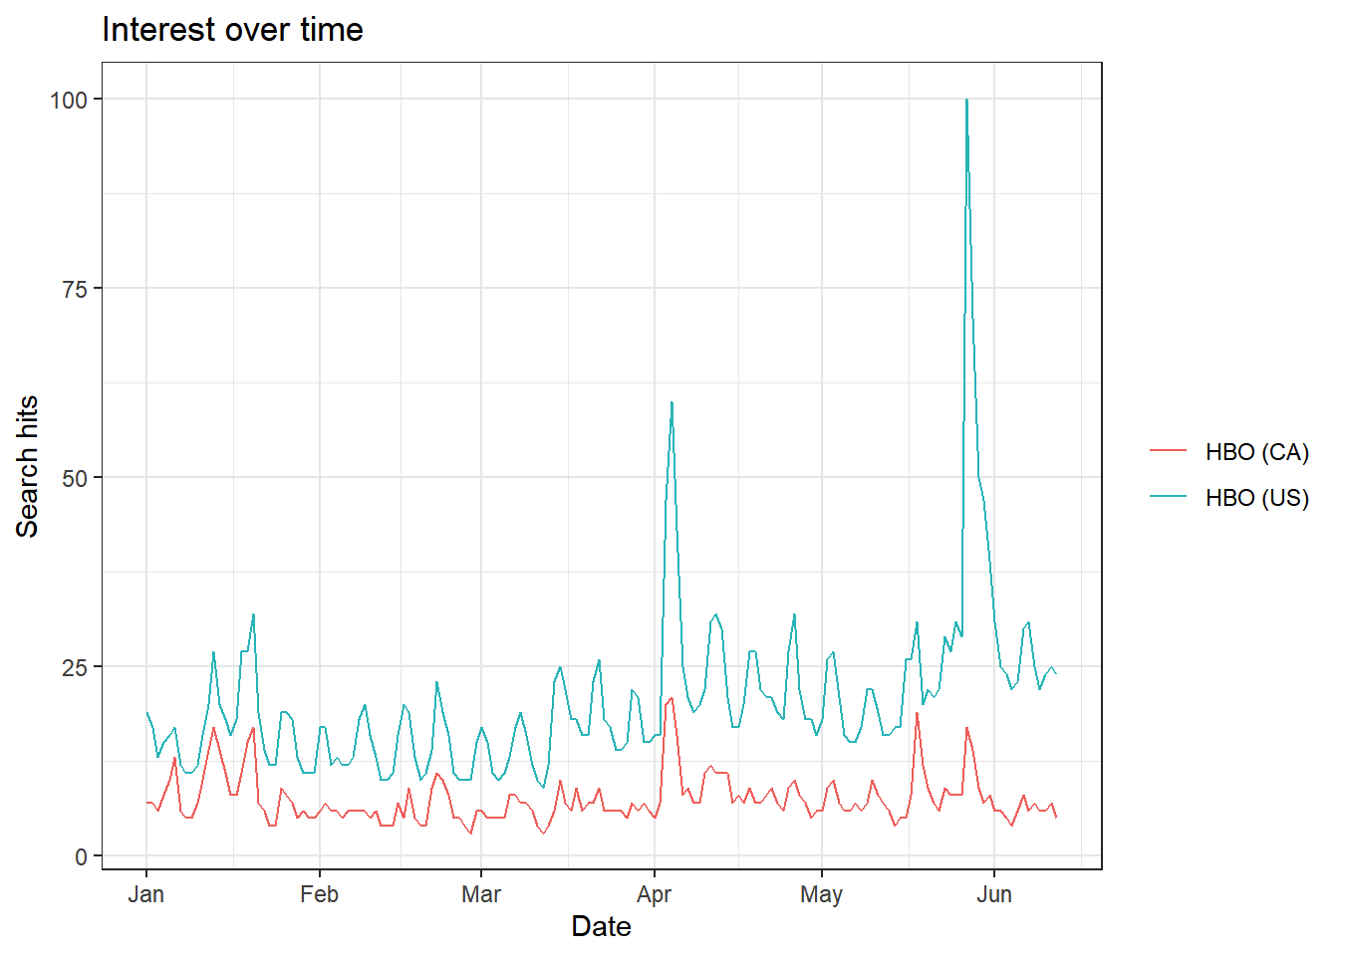
Popularity of the Streaming Services (2020-01-01, 2020-06-13)

Slide 3

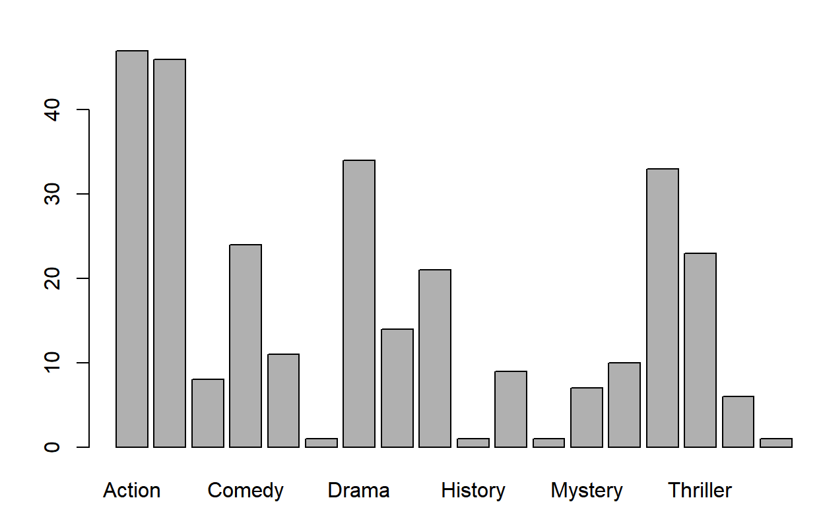
Popular Movie Genres

Slide 4
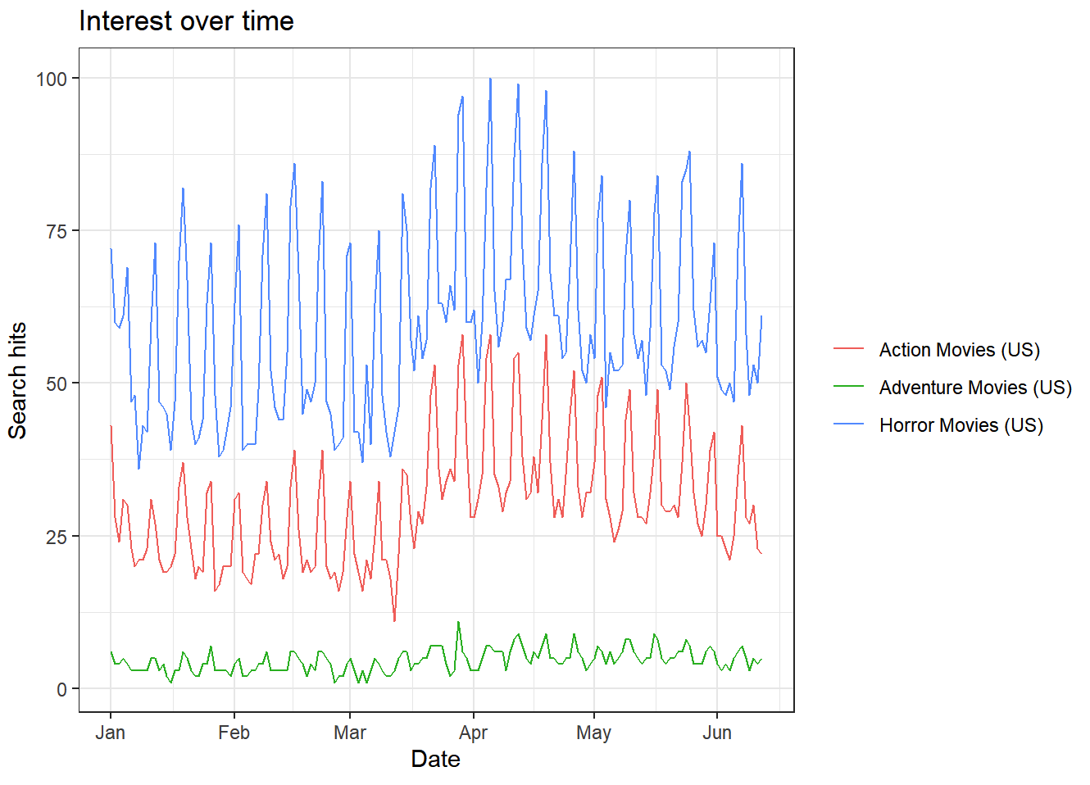
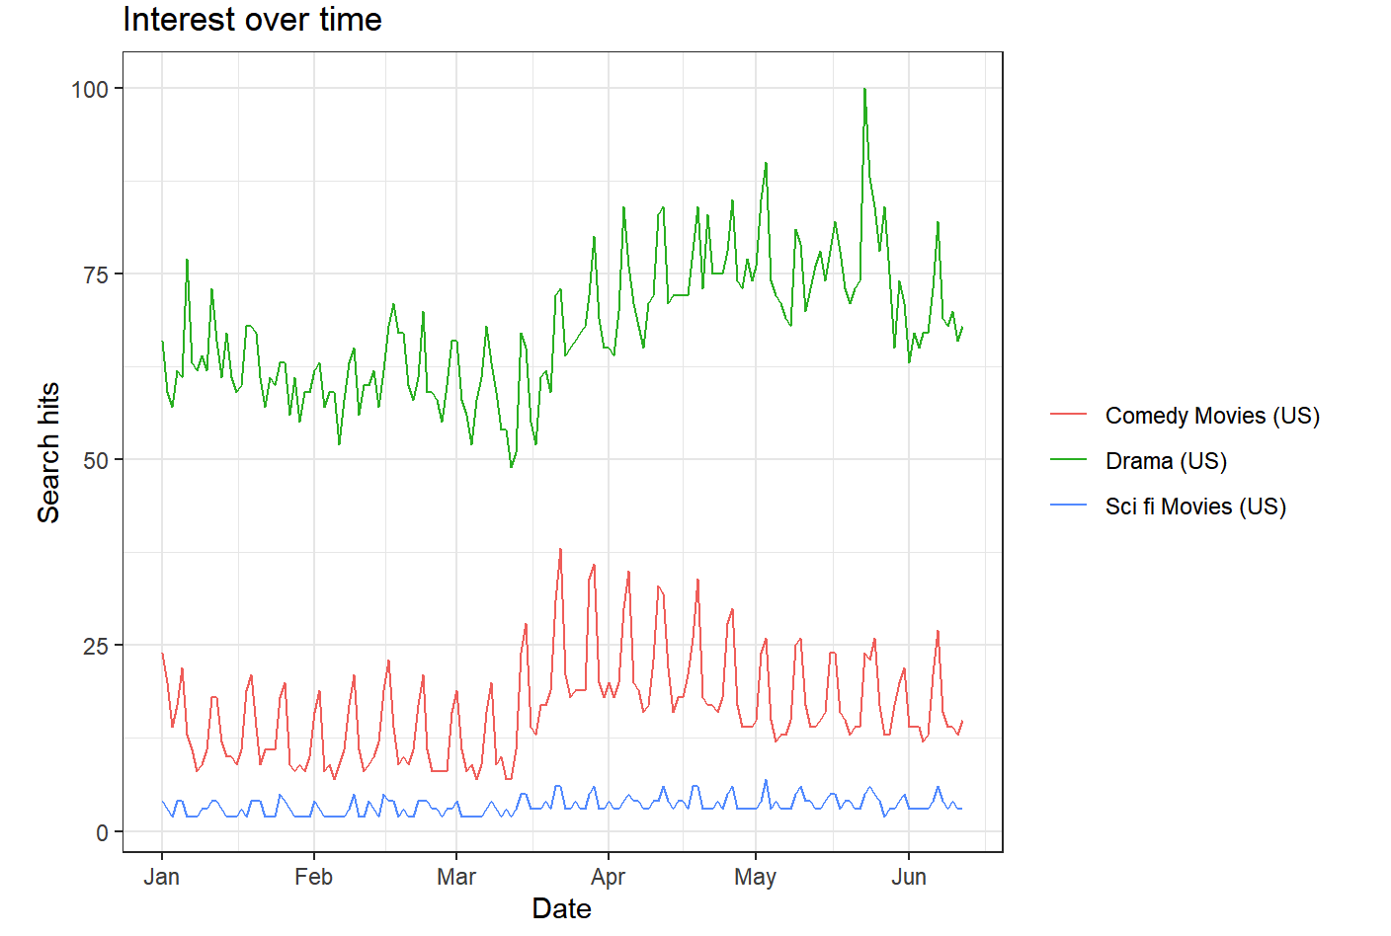
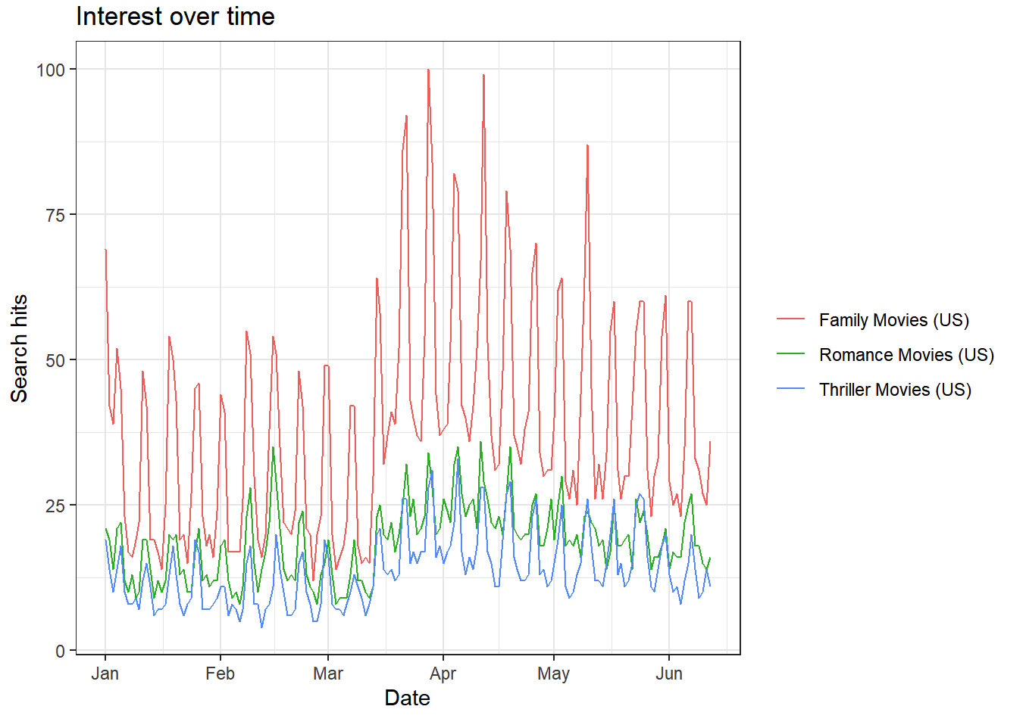
Trends in Popular Movie Genres Since the Lockdown

